Slide 1
Crop Yield and Climate Analysis Dashboard
Presented by: Kalaiyarasi Agricultural Engineering | Aspiring Data Analyst

Slide 2
Project Overview
The Crop Yield and Climate Analysis Dashboard is an interactive Excel dashboard created to analyze:
Crop production
Climate conditions
Seasonal performance
Revenue trends
The dashboard helps users understand the relationship between climate factors and agricultural productivity.

Slide 3
Problem Statement
Agricultural productivity is influenced by multiple factors such as:
Rainfall
Temperature
Humidity
Seasonal changes
Analyzing this data manually is difficult and time-consuming.
Solution:
Create an interactive dashboard to simplify agricultural data analysis and visualization.

Slide 4
Objectives
Analyze crop yield trends
Compare seasonal agricultural performance
Study climate impact on crop production
Visualize revenue and yield distribution
Build an interactive dashboard using Excel

Slide 5
Tools & Technologies Used
Microsoft Excel Features:
Pivot Tables
Pivot Charts
Slicers
Conditional Formatting
Data Cleaning
Dashboard Design

Slide 6
Dataset Information
The dataset includes:
Crop Name
Year
Location
Season
Rainfall
Temperature
Humidity
Yield
Revenue
Data Processing:
Cleaned missing values
Organized data format
Created pivot tables for analysis

Slide 7
Dashboard Features
KPI Cards
Total Yield
Total Revenue
Average Rainfall
Average Temperature
Interactive Filters
Year slicer
Location slicer
Season slicer
Visualizations
Yield trend analysis
Climate comparison
Revenue analysis
Seasonal yield distribution

Slide 8
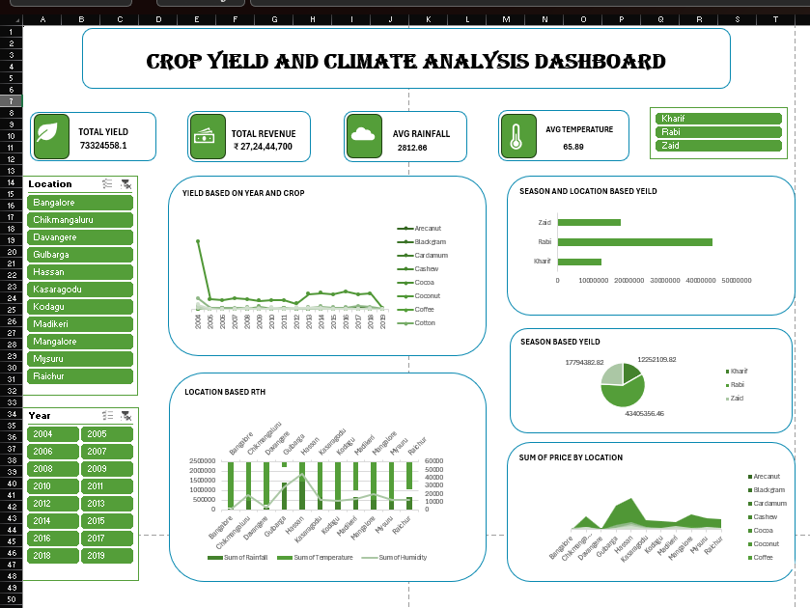
Project Dashboard Overview

Slide 9
Key Insights
Kharif season shows higher crop yield.
Rainfall strongly impacts agricultural productivity.
Different regions show different climate patterns.
Revenue changes based on season and crop performance.

Slide 10
Skills Gained
Through this project, I improved:
Excel Dashboard Development
Data Visualization
Analytical Thinking
Data Cleaning
Interactive Reporting
Business Intelligence Concepts

Slide 11
Conclusion
This project demonstrates how Excel can be used to create interactive dashboards for agricultural analysis.
The dashboard helps simplify complex agricultural and climate data into meaningful visual insights for better decision-making.

Slide 12
THANK YOU

